Slide 1
ReactiveX, RxJs
Basics

Slide 2
Observer pattern
The observer pattern is a software design pattern in which an object, called the subject, maintains a list of its dependents, called observers, and notifies them automatically of any state changes, usually by calling one of their methods.
It is mainly used to implement distributed event handling systems, in "event driven" software.

Slide 3
Iterator pattern
The iterator pattern is a design pattern in which an iterator is used to traverse a container and access the container's elements.

Slide 4
Iterator in ES6
// definition
function makeIterator(array){
var nextIndex = 0;
return {
next: function(){
return nextIndex < array.length ?
{value: array[nextIndex++], done: false} :
{done: true};
}
}
}
// usage
var it = makeIterator(['yo', 'ya']);
console.log(it.next().value); // 'yo'
console.log(it.next().value); // 'ya'
console.log(it.next().done); // true

Slide 5
Functional programming
It’s a programming paradigm that treats computation as the evaluation of mathematical functions and avoids changing-state and mutable data. It is a declarative programming paradigm, which means programming is done with expressions or declarations instead of statements.

Slide 6
Functional programming
In functional code, the output value of a function depends only on the arguments that are passed to the function, so calling a function f twice with the same value for an argument x produces the same result f(x) each time; this is in contrast to procedures depending on a local or global state, which may produce different results at different times when called with the same arguments but a different program state.

Slide 7
Expressions
Expressions are Javascript code snippets that result in a single value. Expressions can be as long as you want them to be, but they would always result in a single value.
assignedVariable + 4 // expression

Slide 8
Statement
Basically, statements perform actions, they do things.
In javascript, statements can never be used where a value is expected. So they cannot be used as function arguments, right-hand side of assignments, operators operand, return values…
const assignedVariable = 2; //this is a statement, assignedVariable is state

Slide 9
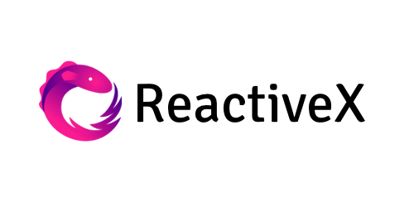
ReactiveX
It’s a combination of the best ideas from the Observer pattern, the Iterator pattern, and functional programming

Slide 10
Observable
In ReactiveX an observer subscribes to an Observable. Then that observer reacts to whatever item or sequence of items the Observable emits.

Slide 11
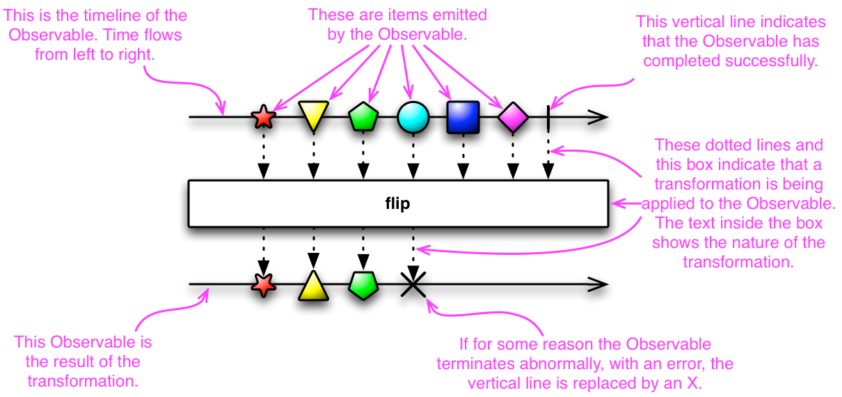

Slide 12
Subscription
onNext
An Observable calls this method whenever the Observable emits an item. This method takes as a parameter the item emitted by the Observable.
onError
An Observable calls this method to indicate that it has failed to generate the expected data or has encountered some other error. It will not make further calls to onNext or onCompleted. The onError method takes as its parameter an indication of what caused the error.
onCompleted
An Observable calls this method after it has called onNext for the final time, if it has not encountered any errors.

Slide 13
Hot’n’Cold Observables
When does an Observable begin emitting its sequence of items? It depends on the Observable. A “hot” Observable may begin emitting items as soon as it is created, and so any observer who later subscribes to that Observable may start observing the sequence somewhere in the middle. A “cold” Observable, on the other hand, waits until an observer subscribes to it before it begins to emit items, and so such an observer is guaranteed to see the whole sequence from the beginning.

Slide 14
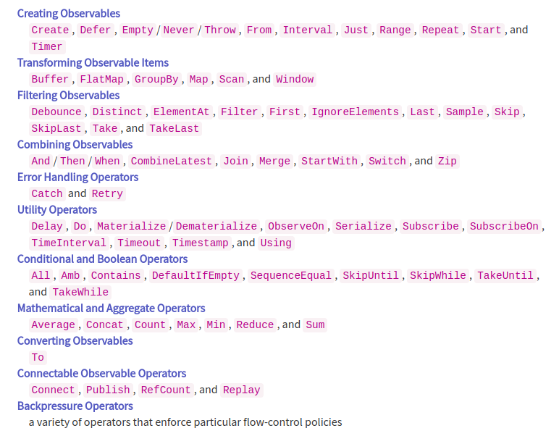

Slide 15
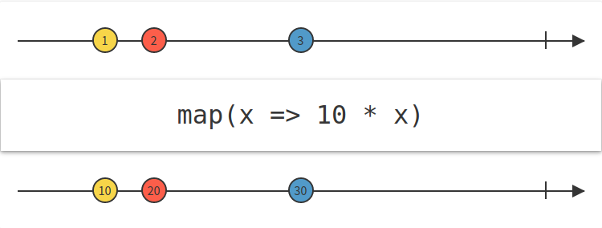
Map

Slide 16
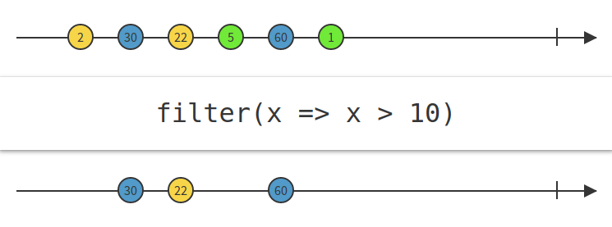
Filter

Slide 17
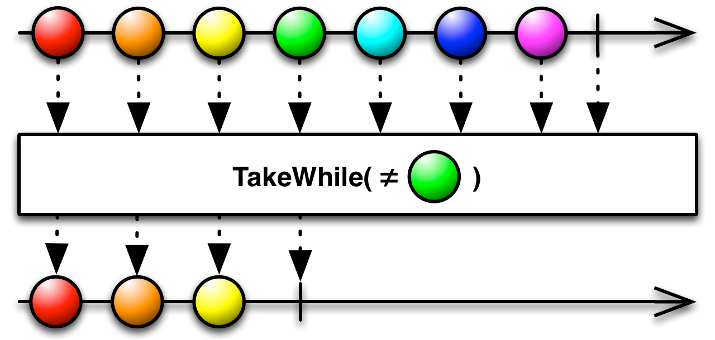
TakeWhile

Slide 18
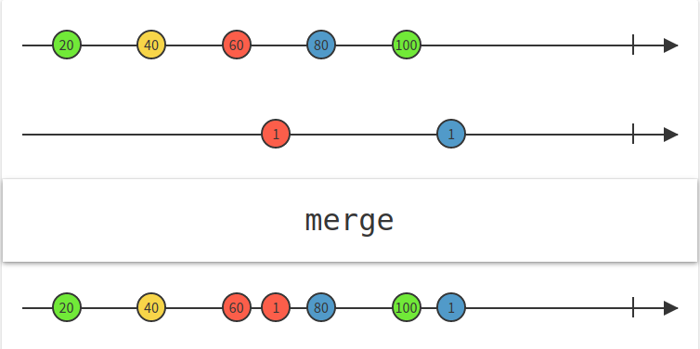
Merge

Slide 19
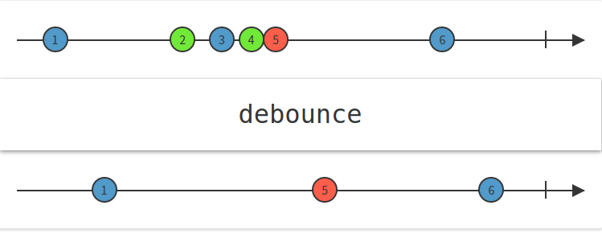
Debounce

Slide 20
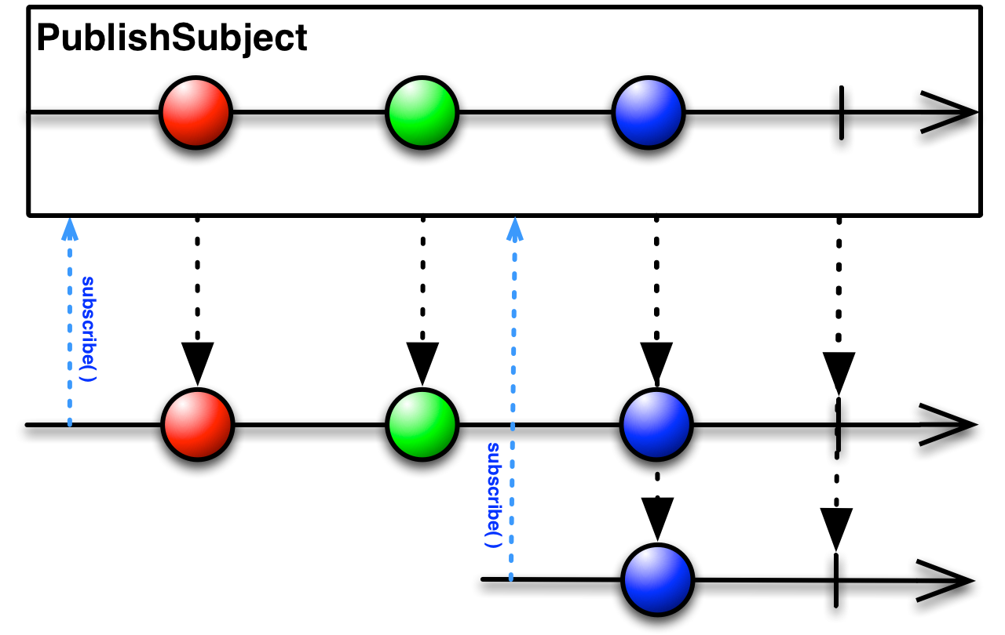
Subject

Slide 21
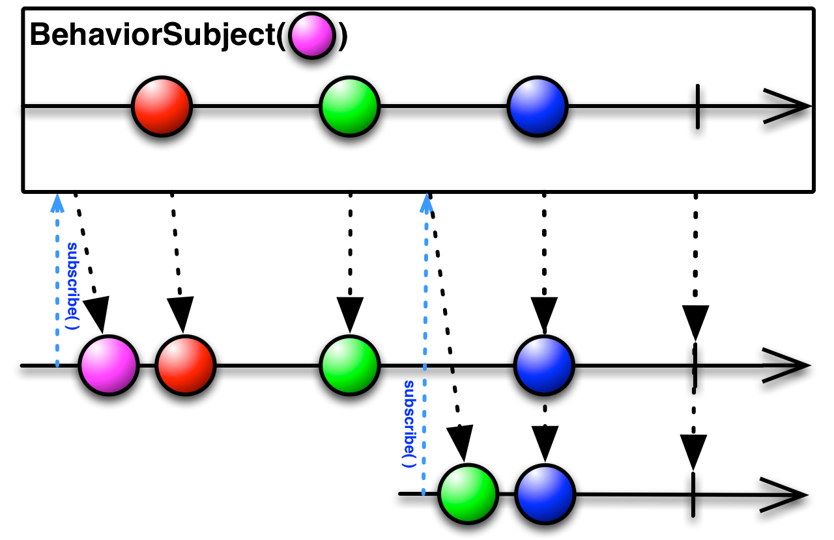
BehaviorSubject

Slide 22
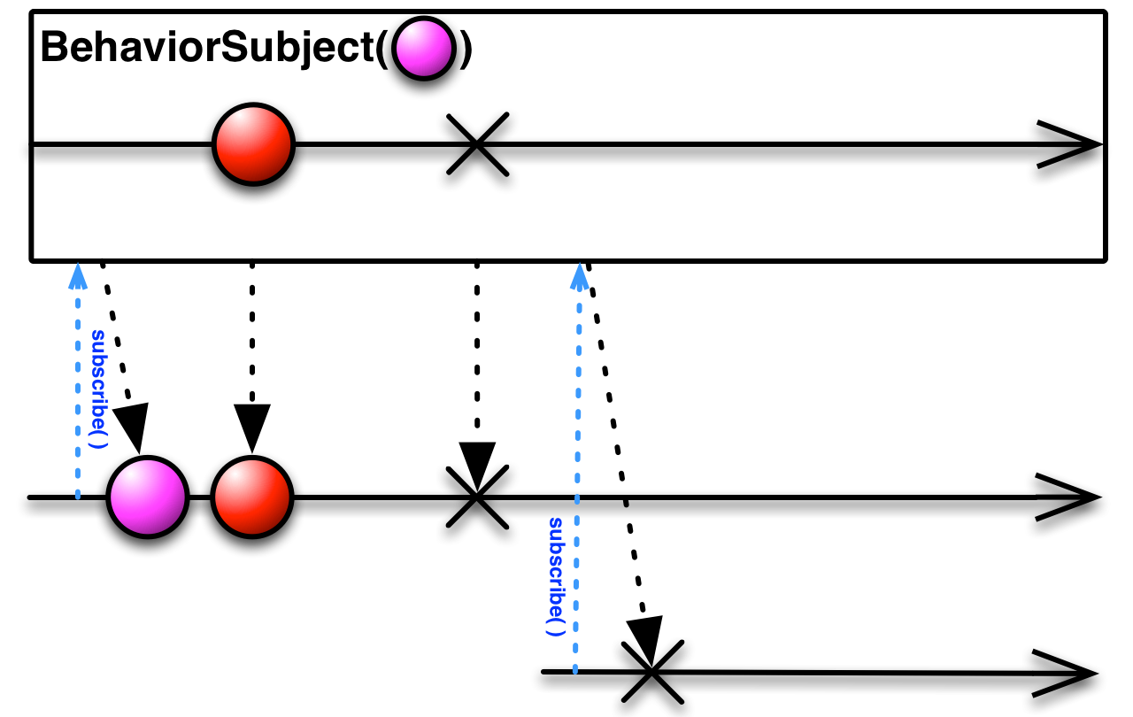
BehaviorSubject

Slide 23
Q&A

